Slide 1

Academic Session 2025-26
Even Semester Jan-Jun’26
Apex Institute of Technology
Department of Artificial Intelligence and Machine Learning
System Design (23CST-390)
Faculty: (Er.) Kamaljeet Kaur (E19147)
DISCOVER . LEARN . EMPOWER
Lecture
Introduction to System Design

Slide 2
Learning Objectives
Understand the fundamental concepts of system design and its importance in building
scalable applications.
Learn the principles of scalability, availability, and reliability in large systems.
Differentiate between Monolithic and Microservices architectures.
Explain key performance metrics such as latency and throughput.
Understand how caching improves system speed and reduces load on backend services.

Slide 3
Course Outcomes
On completion of this course, the students shall be able to:-
CO1 | Understand the fundamental system design principles, including scalability, high availability, and fault tolerance, while analyzing how these core principles influence architectural decisions in real-world distributed environments.
CO2 | Apply various distributed architectural patterns, key database models (SQL and NoSQL), and critical communication protocols to evaluate their specific applications and trade-offs in modern system designs.
CO3 | Apply advanced scaling techniques, such as caching, load balancing, database sharding, and replication, to design system components that effectively handle massive user traffic and data volumes.
CO4 | Analyze the trade-offs between different system architectures, data storage solutions, and consistency models (like the CAP theorem) to select and justify optimized configurations for performance, cost, and reliability goals.
CO5 | Create and document comprehensive, end-to-end system designs that are inherently scalable, distributed, and fault-tolerant, leveraging modern paradigms such as cloud computing and microservices architecture.

Slide 4
Unit-1 Syllabus
Unit-1 | System Design
Introduction to System Design | Introduction to System Design, Functional & Non-Functional Requirements, Scaling Challenges, Load Balancing, Caching Strategies, Replication, Sharding.
Databases in System Design | Databases in System Design – SQL vs NoSQL, CAP Theorem, Distributed Databases, Consistency Models, Eventual Consistency, Distributed Caching (Redis, Memcached), High Availability, Fault Tolerance, Microservices vs Monolithic Architecture.

Slide 5
Topic to be Covered
      Foundations & Requirements
Core Principles
Scaling Strategies
Load Balancing & Caching
Database Architecture
Distributed Theory (CAP)

Slide 6
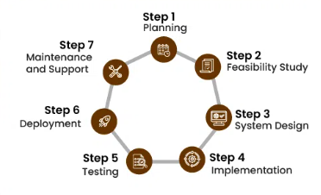
Introduction to System Design
System design defines how components work together to build scalable, reliable systems.
• Designing architecture, components, data flow, and interfaces.
• Ensures performance, scalability, reliability.

Slide 7
Requirements Analysis
Functional Requirements
The "What"
Defines the specific behaviors and functions the system must support.
User can send a message.
System generates an invoice.
Admin can ban users.
Non-Functional Requirements
The "How Well"
Defines the quality attributes of the system.
Scalability: Handle 10k req/sec.
Latency: < 200ms response.
Availability: 99.99% uptime.

Slide 8
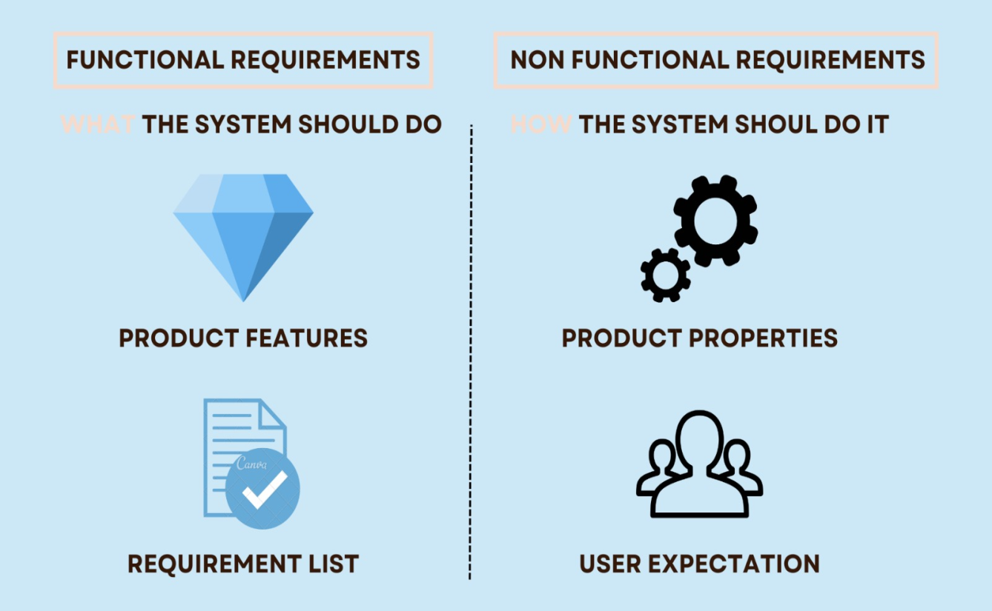
Requirements Analysis

Slide 9
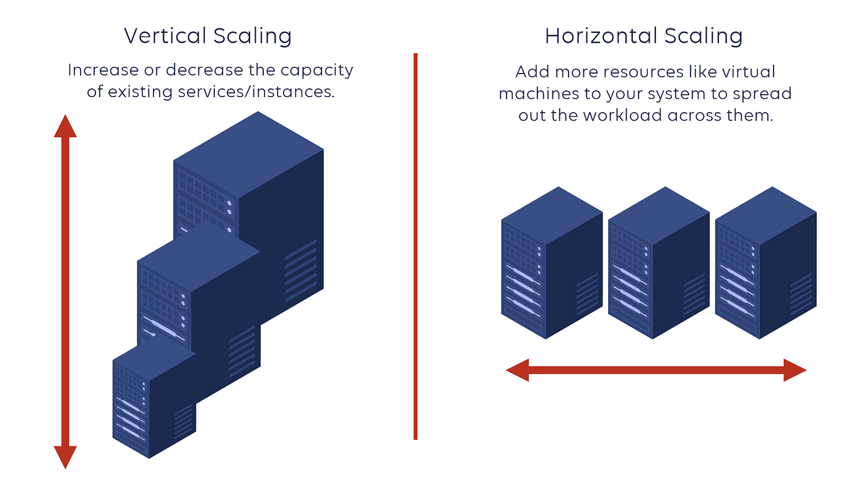
Scaling Strategies
Vertical Scaling (Scale Up): Adding more power (CPU, RAM) to your existing server. Simple, but has a hard ceiling (hardware limits).
Horizontal Scaling (Scale Out): Adding more servers to your resource pool. Requires complex logic to distribute load but offers infinite theoretical scale.

Slide 10
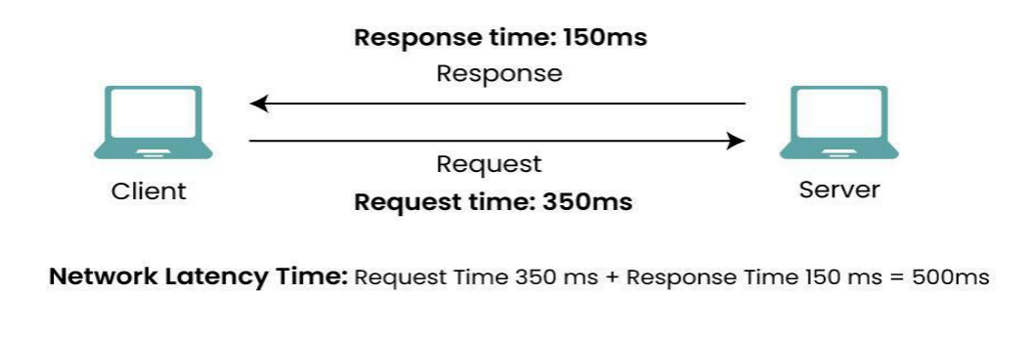
Latency & Throughput
Latency: Time per request.
Throughput: Requests per second

Slide 11
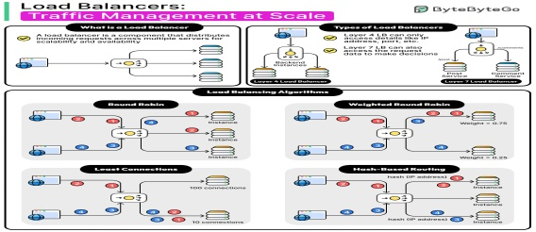
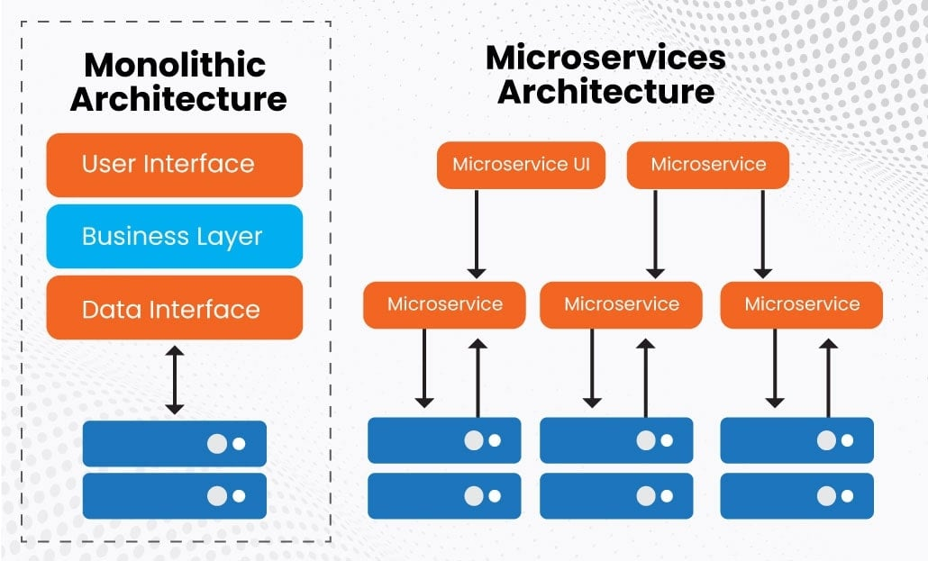
Architecture Patterns
Monolithic: A single codebase where all components are tightly coupled. Easy to develop initially, hard to scale.
Microservices: A collection of loosely coupled services. Each service runs independently and communicates via API.
Allows independent scaling and deployment.
Increases operational complexity.

Slide 12
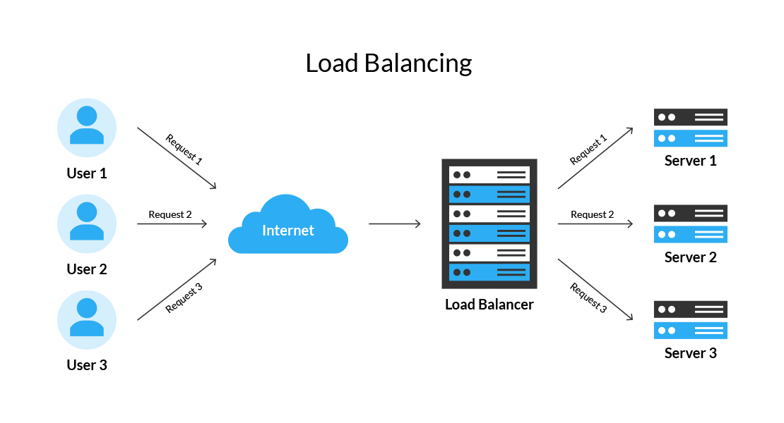
Load Balancing
A Load Balancer (LB) sits between clients and servers. It acts as a traffic cop, distributing incoming requests across multiple healthy servers.
Prevents overload on a single server.
Increases availability (reroutes traffic if a server dies).
Algorithms: Round Robin, Least Connections, IP Hash.

Slide 13
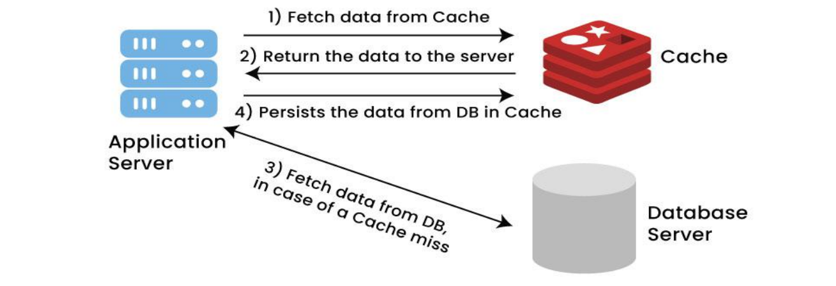
Caching
Caching is the strategy of storing copies of frequently accessed data in fast memory (RAM) to reduce database load and latency.
Read-Through: App checks cache first; if missing, reads from DB and updates cache.
Tools: Redis, Memcached.
Challenge: Cache Invalidation (keeping cache and DB in sync).

Slide 14
Core Principles
Reliability
The system continues to function correctly even when things go wrong (hardware failure, software faults, human error).
Scalability
The system's ability to cope with increased load (e.g., more users, more data) by adding resources.
Maintainability
How easy it is for engineers to understand the system, fix bugs, and add new features over time.

Slide 15
SQL vs NoSQL
SQL (Relational)
Structured data with strict schemas.
ACID transactions
Atomicity, Consistency, Isolation, Durability.
Good for complex queries (JOINs) and financial data.
MySQL PostgreSQ
NoSQL (Non-Relational)
Flexible schema for unstructured data.
BASE consistency
Basically Available, Soft state, Eventual consistency.
Great for high throughput and horizontal scaling.
MongoDB Cassandra

Slide 16
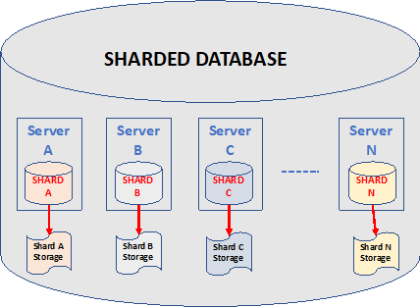
Database Sharding
Sharding involves splitting a large database into smaller, faster, more easily managed parts called shards.
Horizontal Partitioning: Rows are distributed across different servers based on a Shard Key (e.g., UserID).
Pros: Unlimited storage scaling.
Cons: Complex queries (joins) across shards are difficult.

Slide 17
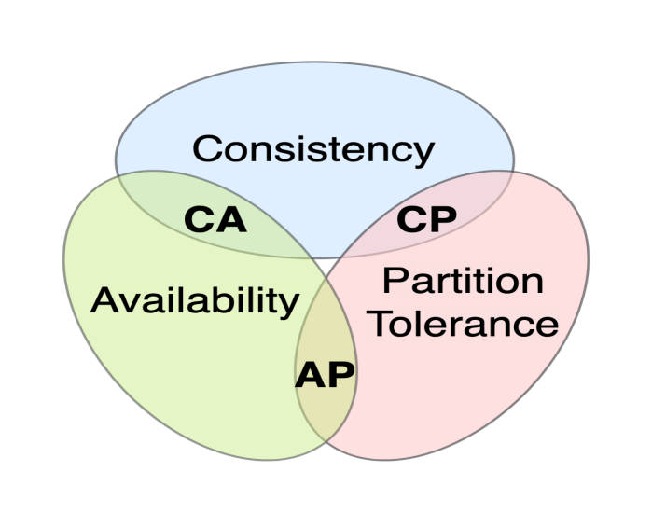
The CAP Theorem
In a distributed data store, you can only guarantee two of the following three:
Consistency: Every read receives the most recent write.
Availability: Every request receives a response (even if data is stale).
Partition Tolerance: The system works despite network failures.

Slide 18
Introduction to Distributed Databases
A distributed database is a database that runs and stores data across multiple computers, as opposed to doing everything on a single machine.
Typically, distributed databases operate on two or more interconnected servers on a computer network.
Each location where a version of the database is running is often called an instance or a node.
A distributed database is basically a database that is not limited to one system, it is spread over different sites, i.e, on multiple computers or over a network of computers.
A distributed database system is located on various sites that don’t share physical components.

Slide 19
Summary of the Lecture
Scalability, Availability, and Reliability:
The lecture explained how systems must grow with user demand (scalability), stay accessible without downtime (availability), and function correctly even during failures (reliability).
Monolithic vs Microservices:
We learned the difference between a single, unified application (monolith) and a collection of small, independent services (microservices), including when each approach is useful.
Latency and Throughput:
These performance metrics were discussed to understand system efficiency—latency measures response time, while throughput measures how many requests a system can handle per second.
Caching:
The lecture highlighted caching as a method to store frequently accessed data for quick retrieval, helping to reduce load on servers and speed up system performance.

Slide 20
Next Lecture
Load Balancing Algorithms (RR, Weighted RR, Least Connection)
Caching Strategies – Cache Placement and Policy Client-Side vs. Server-Side Caching
CDN Basics Cache Invalidation and Advanced Caching Patterns
Replication – Master-Slave and Multi-Master Architectures

Slide 21
Quiz/ FAQ’s
1. What is the main difference between vertical and horizontal scaling?
A. Vertical scaling adds more machines; horizontal scaling increases RAM
B. Vertical scaling increases resources of one machine; horizontal scaling adds more machines
C. Both increase CPU only
D. None of the above
Correct Answer: B
2. Which component helps distribute traffic among multiple servers?
A. Cache
B. Database
C. Load Balancer
D. API Gateway
Correct Answer: C
3. What is the purpose of caching in a system?
A. To store data permanently
B. To speed up data retrieval by storing frequently accessed data
C. To replace the database
D. To improve microservices communication
Correct Answer: B

Slide 22
References/ Articles/ Videos
Book Reference:
System Design Guide for Software Professionals- Kindle Edition by Dhirendra Sinha (Author), Tejas Chopra (Author) Format
Tutorial Link:
https://www.geeksforgeeks.org/system-design/system-design-tutorial/
Video Link:
https://www.youtube.com/results?search_query=Introduction+to+System+Design
https://x.com/ShradhaKhapra_

Slide 23

Class-Wise Feedback

Slide 24
Thank You
For queries Email: kamaljeet.e19147@cumail.in

